Slide 1
Module 2:
Privacy
Philosophy, Law, and Technology
ML for Cybersecurity

Slide 2
Privacy is Hard to Define
“Privacy is a value so complex, so entangled in competing and contradictory dimensions, so engorged with various and distinct meanings, that I sometimes despair whether it can be usefully addressed at all.” Robert C. Post, Three Concepts of Privacy, 89 Geo. L.J. 2087 (2001)

Slide 3
Defining Privacy

Slide 4
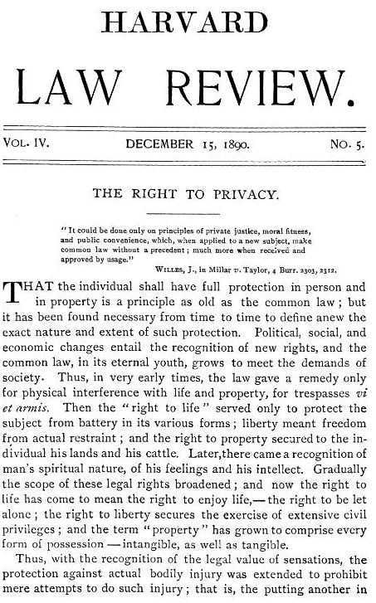
The Right to Be Let Alone
Warren and Brandeis, Harvard Law Review, 1890
Spurred by photography in gossip pages about high society
Libel and slander are insufficient in considering only damage to reputation
The right to prevent, rather than profit from, publication
Excludes topics of general interest

Slide 5
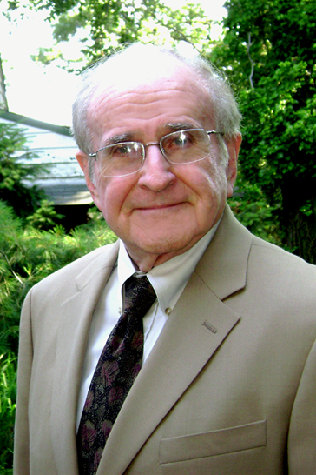
Privacy as Control
Alan Westin, Privacy and Freedom, 1967
“Privacy is the claim of individuals, groups or institutions to determine for themselves when, how, and to what extent information about them is communicated to others.”
“…each individual is continually engaged in a personal adjustment process in which he balances the desire for privacy with the desire for disclosure and communication….”

Slide 6

Boundary Regulation
Irwin Altman, 1975
Privacy is a dialectic and dynamic process of boundary regulation
Continuous movement on a continuum
Goal: optimize balance of privacy and social interaction

Slide 7

Balance Costs and Benefits
Sandra Petronio, 1991
Communication Privacy Management (CPM) Theory
Regulate boundaries based on perceived costs and benefits
Rule-based management is expected
Boundary turbulence related to clashing expectations

Slide 8

Contextual Integrity
Helen Nissenbaum, 2004
“Contextual integrity ties adequate protection for privacy to norms of specific contexts, demanding that information gathering and dissemination be appropriate to that context.”
Parameters: data subject, sender, recipient, information type, and transmission principle

Slide 9
Applying Privacy to Cybersecurity ML
Imagine that [ML cybersecurity example from Nick’s lecture]
How do we think about the collection and use of user data for training the model if we define privacy in the following ways?
The right to be let alone (Warren/Brandeis)
Control (Westin)
Boundary regulation (Altman / Petronio)
Contextual integrity (Nissenbaum)

Slide 10
Privacy Regulation & LAW

Slide 11
Fair Information Practice Principles (FIPPs)
US Federal Trade Commission (FTC), building on earlier frameworks
Notice / Awareness
Choice / Consent
Access / Participation
Integrity / Security
Enforcement / Redress

Slide 12
FTC’s Regulatory Tools
Unfair practices
Injure consumer
Violate established policy
Unethical
Deceptive practices
Mislead consumer
Differ from reasonable consumer expectations

Slide 13
General Data Protection Regulation (GDPR)
Came into effect May 25, 2018 and applies to the EU
Distinguishes between data subjects, controllers (people who direct analysis), and processors (those who do the analysis)
Controller informs the “data subject in a concise, transparent, intelligible and easily accessible form”
Right of access for data subjects
Right of erasure (with some exceptions)
Right to object to processing for some purposes
Privacy by design (Article 25)

Slide 14
General Data Protection Regulation (GDPR)
Pseudonymization required for stored personal data
Data breach notification to authorities within 72 hours
Possible fines of up to 4% of worldwide turnover
Can only process data based on six lawful bases:
Consent
Contract
Public task
Vital interest
Legitimate interest
Legal requirement

Slide 15
California Consumer Privacy Act (CCPA)
Came into effect January 1, 2020 and applies to California residents
Residents of California have rights to:
Know what personal data is collected
Know whether that data is sold
Refuse the sale of personal data
Access their data
Request erasure of their personal data
Not be discriminated against for exercising these privacy rights
Fine of $7,500 for intentional and $2,500 for unintentional violations

Slide 16
ML Cybersecurity Under GDPR/CCPA
What aspects of privacy do we need to consider for an ML model to comply with GDPR and CCPA?
Does this meet all user needs / desires?

